Slide 1


Predicting Customer Churn for Business Growth
(Proyect-TelecomX-1-ETL-Latam-Cynthia_-Challenge Telecom X análisis de evasión de clientes - Parte 2)

Slide 2
Agenda
Project Overview
01
02
03
Analytical Summary
Project Outline
Model Comparison
Overview of churn prediction pipeline
Steps taken in the analysis
Performance evaluation of ML models
04
05
06
Key Factors
Patterns Identified
Strategies to Reduce Churn
Drivers of customer churn
High-risk and protected segments
Actionable retention plans
07
Conclusion
Summary of findings and next steps

Slide 3
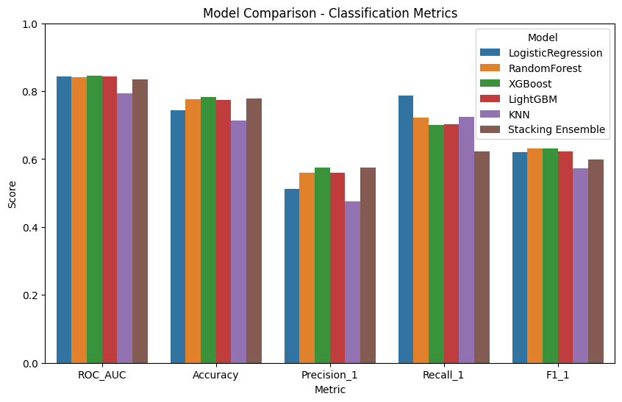
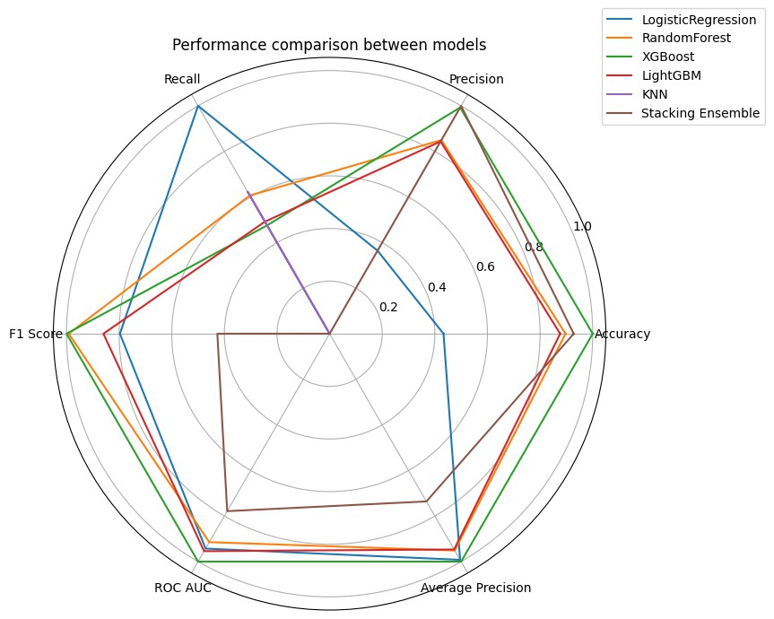
Section 1
Analytical Summary
A robust pipeline was built to anticipate customer churn using machine learning techniques and explanatory analytics.
The XGBoost model performed best, standing out for its robustness, balance, and ability to correctly identify the positive class (churn).

Slide 4
Project Outline: Our Methodical Approach
Section 2
Our analysis followed a comprehensive, multi-stage process to ensure accuracy and interpretability:
Exploratory Analysis & Data Preparation
1
Initial data understanding and cleaning.
2
Correlation Analysis & Balancing
Identifying relationships and addressing data imbalance.
Multi-Model Training & Optimization
3
KNN, LG RF, RL, XGB, and Ensemble models with hyperparameter
tuning (GridSearchCV).
4
Model Comparison & Interpretation
Evaluating performance and understanding feature contributions (SHAP & Feature Importance).
Final Report & Strategy
5
Consolidating insights into actionable recommendations.

Slide 5
Model Comparison: Performance Metrics
Section 3
After rigorous evaluation, the XGBoost model demonstrated superior overall balance and predictive power.
Model | Accuracy | Precision | Recall | F1 Score | ROC AUC | Observations
XGBoost | 0.783 | 0.575 | 0.701 | 0.631 | 0.845 | Good overall balance, excellent ROC AUC, and high recall
LightGBM | 0.774 | 0.560 | 0.703 | 0.623 | 0.843 | Very similar to XGBoost, good recall and precision
RandomForest | 0.776 | 0.560 | 0.722 | 0.631 | 0.841 | High recall, good overall balance
LogisticRegression | 0.744 | 0.511 | 0.786 | 0.620 | 0.843 | Better recall (sensitivity), lower precision
Stacking Ensemble | 0.779 | 0.578 | 0.623 | 0.600 | 0.834 | Better precision, slightly lower recall and F1
KNN | 0.714 | 0.475 | 0.725 | 0.574 | 0.794 | Lower accuracy and precision, but acceptable recall

Slide 6

Confusion Matrix Insights
Section 3
Analysis of the Confusion Matrix confirms XGBoost's effectiveness in balancing churn identification and false alarms.
Model | TN | FP | FN | TP | Observations
XGBoost | 841 | 194 | 112 | 262 | Better TN (low FP), FN similar to LightGBM
LightGBM | 828 | 207 | 111 | 263 | Good Balance, somewhat more FN than KNN, but less FP
RandomForest | 823 | 212 | 104 | 270 | Balanced, FN slightly better than XGBoost
LogisticRegression | 754 | 281 | 80 | 294 | Better FN (fewer false negatives), more FP (risk of higher costs)
Ensemble (Stacking) | 865 | 170 | 141 | 233 | Better TN (less FP), more FN (risk of losing churning customers)
KNN | 735 | 300 | 103 | 271 | Good Recall (high TP), many False Positives (high FP)
Selected Model: XGBoost. Robust, well-balanced, and ideal for minimizing customer loss (high recall) while avoiding false alarms (reasonable accuracy).
Adapts well to various business cases.

Slide 7

Key Churn Factors
Section 4
We utilized SHAP and correlation analysis to identify variables influencing churn probability.
Factors Increasing Churn: Factors Decreasing Churn:
Contract Month to Month: Low commitment, easy to leave.
Internet Fiber Optic: Customers with more alternatives.
Payment Electronic Check: Volatile profile, lower contractual commitment.
Paperless Billing: Digital customer, often attentive to new offers.
Customer Tenure: Longer tenure, greater loyalty.
Two-year Contract: Long contracts limit exits.
Internet TechSupport: Technical support adds value, reduces churn.
Internet OnlineSecurity: Additional protections build trust.
No Internet: Less incentive to leave.
Mixed Effects:
Internet StreamingMovies & StreamingTV: Effect depends on other variables (e.g., contract type, additional services).

Slide 8
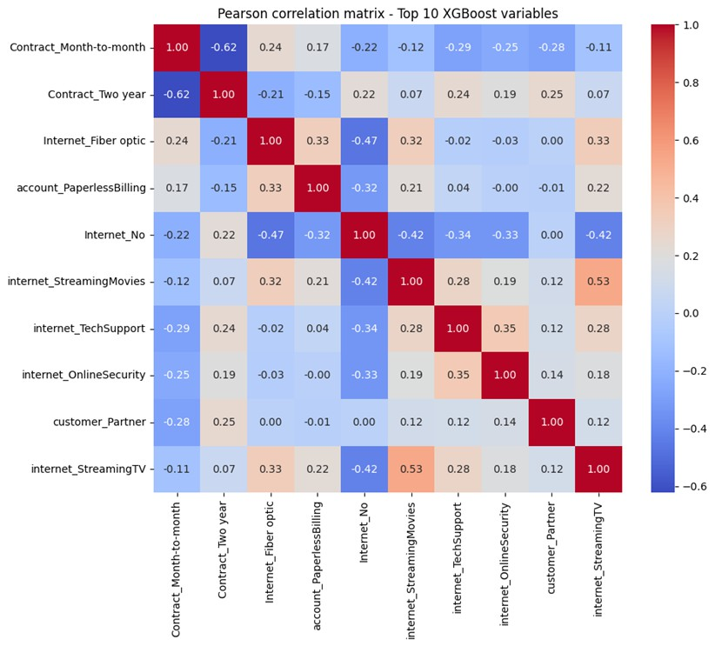
Identified Churn Patterns
Section 5
High-Risk Segment
Monthly contracts, low tenure.
Fiber optics, e-check payments, e-invoicing.
Profile: Digital-savvy, short-term commitment, potentially flighty.
Protected Segment
Two-year contracts, long tenure.
Utilize additional services (tech support, online security).
Profile: Loyal, value-added service-oriented, stable.
Key Interactions: Long contract + additional services maximize retention. New customer + monthly contract + digital services = highest risk.

Slide 9
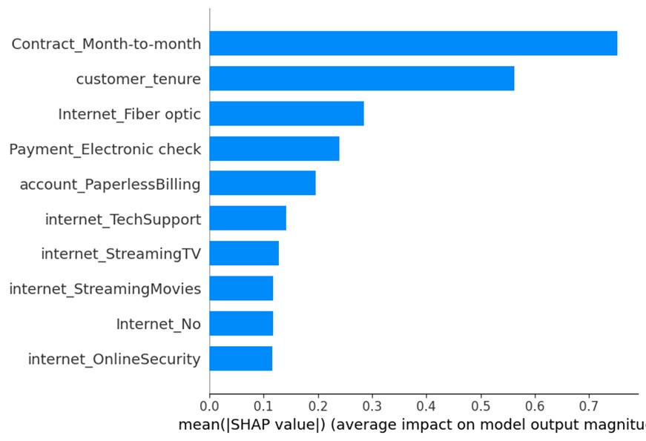
Actionable Churn Reduction Strategies
Section 6
High-Retention Customers
Enhance technical support & security.
Offer upgrades and bundled
packages.
Proactive loyalty programs.
High-Risk Customers
Incentivize longer contracts with benefits.
Improve fiber service experience & promotions.
Promote automatic payment methods.
Personalize digital communications.
General Strategies
Improve onboarding for initial engagement.
Use predictive models for early detection.
Optimize digital self-service and support.
Personalize streaming offers based on profile and bundle with other services.

Slide 10
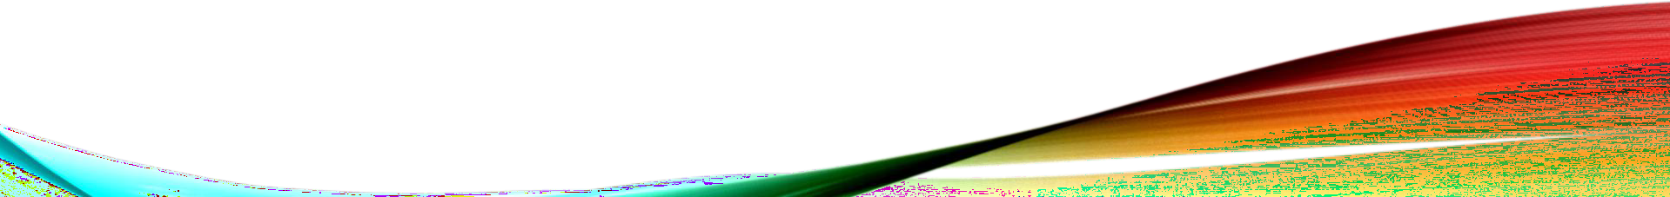
Driving Loyalty, Reducing Churn
Conclusion
Robust Pipeline
Advanced preprocessing, variable selection, and class balancing significantly improved predictive capacity.
Interpretable Insights
Combined SHAP with non-linear models for clear,
explainable churn drivers.
Actionable Strategies
Derived strategies are clear, actionable, and ready for immediate implementation by marketing and retention teams.
Key Factors Validated
Contract type, payment method, customer tenure, and additional services are primary churn influences.
This combined approach provides a solid foundation for designing customized interventions to increase loyalty and reduce customer churn.

